Slide 1
Course Assistant
Course Manager and Tracker
Team
Md. Ahasan Khan - 011201122
Asif Uddin Ahmed - 011201129
Sunny Sutradhar - 011201084

Slide 2
Introduction
01
02
Sharing Contents
Sharing course materials and own written notes with own university sudents.
Tracking Progression
Analyze and predict result and visualization of results based on given data additionally provides tips based on situations.

Slide 3

Features
Share Content
Track Result
Student can share their trimester content with others.
Tracking results of current and all previous trimester with only one click.
Request Content
Visualize Progression
Student can request for specific course materials or topic.
Visualize progression with graph, pie chart, histogram for better undertanding.
Content Suggestion
Tips and Tricks
Suggest content based on student’s department and result progress.
Tips to improve or keep current progress pace based on results.

Slide 4
Responsibilities
Content Sharing
Progress Tracking
Lead - Sunny Sutradhar
Support – Md. Ahasan Khan Asif Uddin Ahmed
Lead – Md. Ahasan Khan
Support – Asif Uddin Ahmed Sunny Sutradhar

Slide 5






Frameworks and Languages
TailwindCSS
Bootstrap
Frontend
Backend
Database

Slide 6
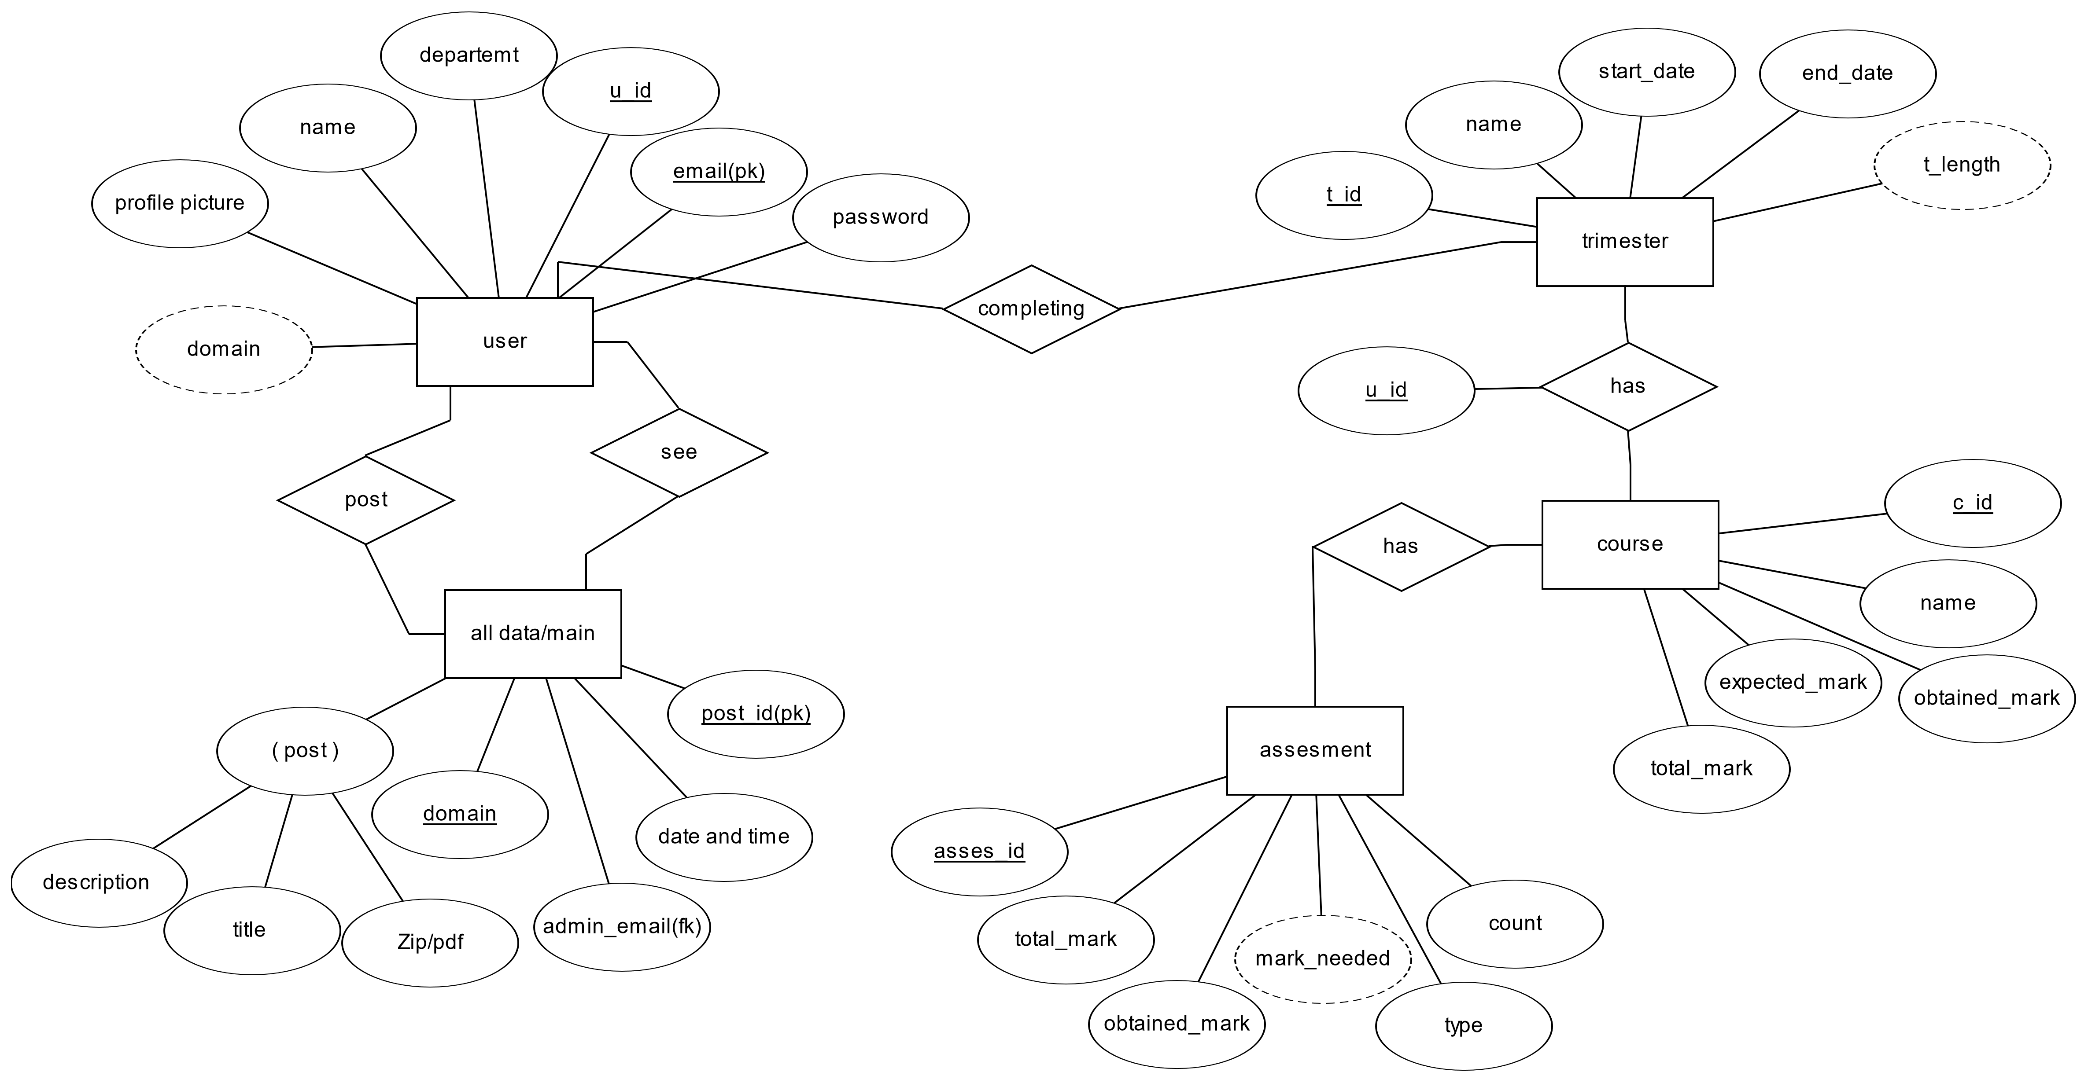
ER-Diagram
creates

Slide 7
Thanks
Do you have any questions?
mkhan201122@bscse.uiu.ac.bd
aahmed201129@bscse.uiu.ac.bd
ssutradhar201084@bscse.uiu.ac.bd

